Slide 1
Suicide and Risk
Monica Bellucci, M.Ed, LMHC

Slide 2
Language/Stigma
In no other instances of death do we place the blame on the person, except when they die by suicide.
“Commited Suicide”
What are other things we Commit?
Adulty
Sin
A Felony
AN INDIVIDUAL DIED BY SUICIDE

Slide 3
Preferred Language
•Suicidal thoughts vs Suicidal Intensity
•Committed, Completed vs died by suicide
•Successful vs Failed
•Serious vs level of lethality
•Attention seeking vs Attention needing

Slide 4
Suicide rates from 2021 (CDC)

Slide 5
For every death by suicide
3 hospitalizations for self-harm**
8 emergency department visits related to suicide***
38 self-reported suicide attempts in the past year****
265 people who seriously considered suicide in the past year****
*Based on the latest year of available data for adults ages 18 and older.
**Source: HCUP National Inpatient Sample (2020)
***Source: CDC WISQARS (2020)
****Source: SAMHSA National Survey on Drug Use and Health (2021)

Slide 6
Demographics
The suicide rate among males in 2021 was approximately four times higher than the rate among females. Males make up 50% of the population but nearly 80% of suicides
Elder Adults 75 years or older, have the highest percentage of suicide deaths per age group
Middle-aged people, especially men, have the highest rate of suicide compared to other groups. Eighty percent of all deaths by suicide in the U.S. are among men and women age 45-54.

Slide 7
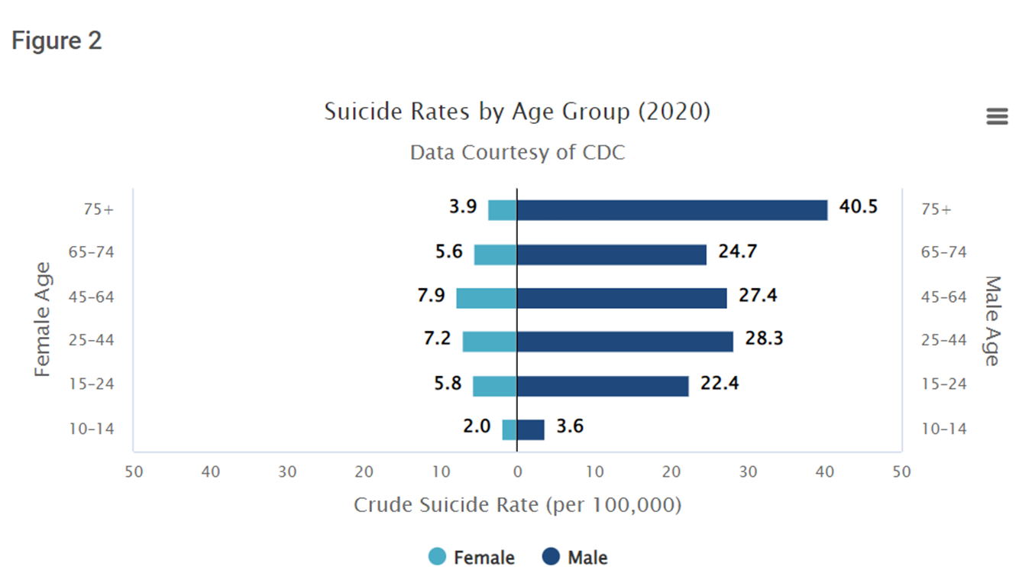

Slide 8
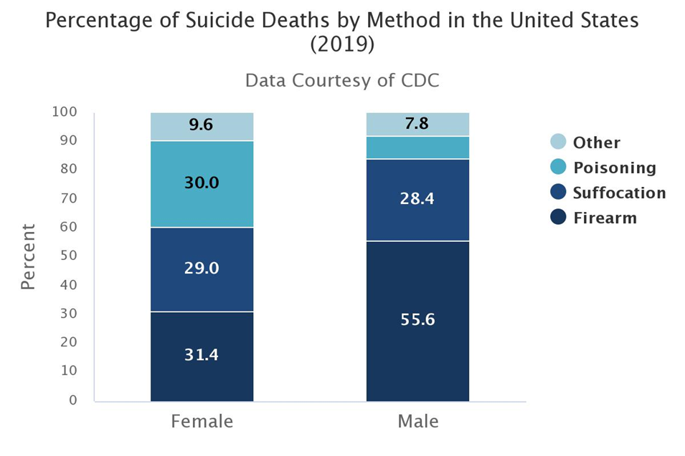

Slide 9
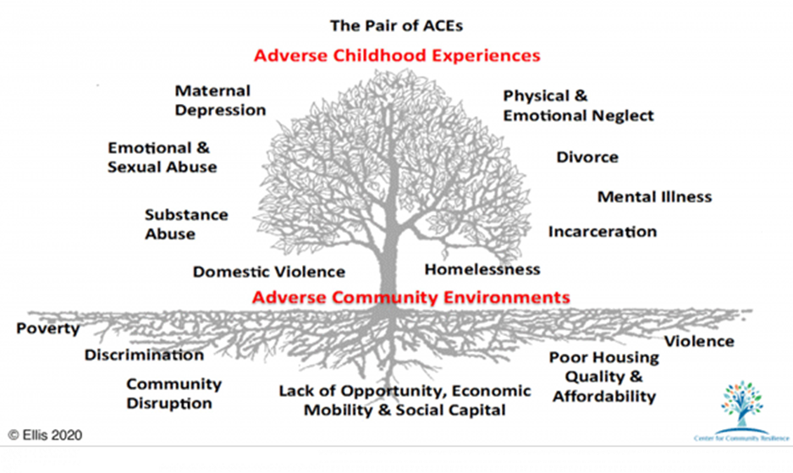

Slide 10
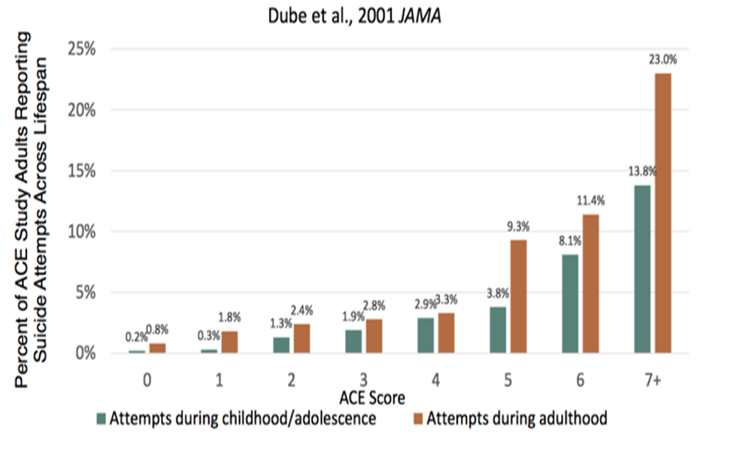

Slide 11
Individual Risk Factors
These personal factors contribute to risk:
Previous suicide attempt
History of depression and other mental illnesses
Serious illness such as chronic pain
Criminal/legal problems
Job/financial problems or loss
Impulsive or aggressive tendencies
Substance use
Current or prior history of adverse childhood experiences (ACES)
Sense of hopelessness
Violence victimization and/or perpetration

Slide 12
Relationship Risk Factors
These harmful or hurtful experiences within relationships contribute to risk:
Bullying
Family/loved one’s history of suicide
Loss of relationships
High conflict or violent relationships
Social isolation

Slide 13
Community Risk Factors
These challenging issues within a person’s community contribute to risk:
Lack of access to healthcare
Suicide cluster in the community
Stress of acculturation
Community violence
Historical trauma
Discrimination

Slide 14
Societal Risk Factors
These cultural and environmental factors within the larger society contribute to risk:
Stigma associated with help-seeking and mental illness
Easy access to lethal means of suicide among people at risk
Unsafe media portrayals of suicide
Exposure to another person’s suicide, or to graphic or sensationalized accounts of suicide

Slide 15
Historical Risk Factors
Previous suicide attempts
Family history of suicide
Childhood abuse, neglect or trauma (ACES)

Slide 16
Individual Protective Factors
These personal factors protect against suicide risk:
Effective coping and problem-solving skills
Reasons for living (for example, family, friends, pets, etc.)
Strong sense of cultural identity
Religion

Slide 17
Relationship Protective Factors
These healthy relationship experiences protect against suicide risk:
Support from partners, friends, and family
Feeling connected to others

Slide 18
Community Protective Factors
These supportive community experiences protect against suicide risk:
Feeling connected to school, community, and other social institutions
Availability of consistent and high quality physical and behavioral healthcare

Slide 19
Societal Protective Factors
These cultural and environmental factors within the larger society protect against suicide risk:
Reduced access to lethal means of suicide among people at risk
Cultural, religious, or moral objections to suicide

Slide 20
How Does a Suicide Occur?
Feelings/thoughts of not belonging
Feelings/thoughts of being a burden
Those capable of suicide
Underlying vulnerability (MI/SU, Aggression, Family Hx, Sexual Orientation etc)
Stress event (Trouble with Law/School, Breakup, Loss etc)
Acute Mood Change (Anxiety, Dread, Hopelessness, Anger)
Strong taboo of suicide, available support, slowed down mental state presence of others = Survival
Weak taboo of suicide, means/weapon available, agitation, being alone = Suicide/Serious Attempt

Slide 21
Be Direct When Asking About Suicide
Ask Direct Questions
Are you thinking about killing yourself?
Do you have a plan? (specific)
What is your intent?
Do you have the means?
DO NOT BE VAGUE
Have you thought about hurting yourself?

Slide 22
Self Harming Behaviors
Cutting
Scratching
Burning
Self Hitting
Head Banging
DO ANY OF THESE INJURIES REQUIRE MEDICAL ATTENTION
WHAT IS THE INTENT OF THE BEHAVIOR

Slide 23
Risk Factors For Self Harm
People are more likely be at risk for self-harming behaviours if certain factors are present, such as:
loss of a parent;
childhood illness or surgery;
childhood sexual or physical abuse;
family substance abuse;
negative body image perceptions;
lack of impulse control;
childhood trauma; (ACES)
neglect;
lack of strong family attachments.
(Briere and Gil, 1998; CSP, 2014)

Slide 24
Why Do People Self Harm
Possible reasons for self harm
To reduce negative emotions
To feel “something”
To over come suicidal thoughts
To avoid certain situations/emotions
To access social supports

Slide 25
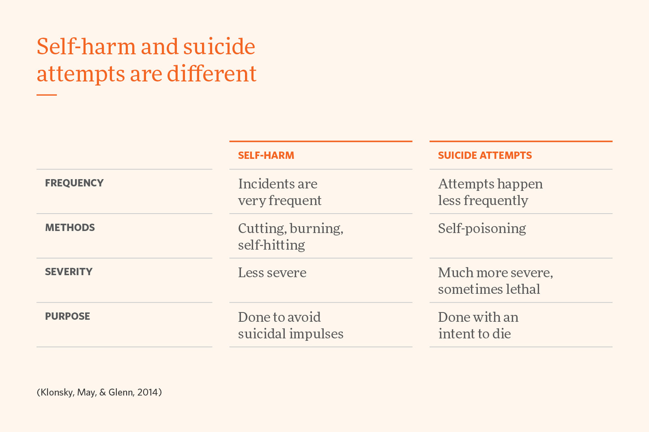
Self Harm vs Suicide Attempts

Slide 26
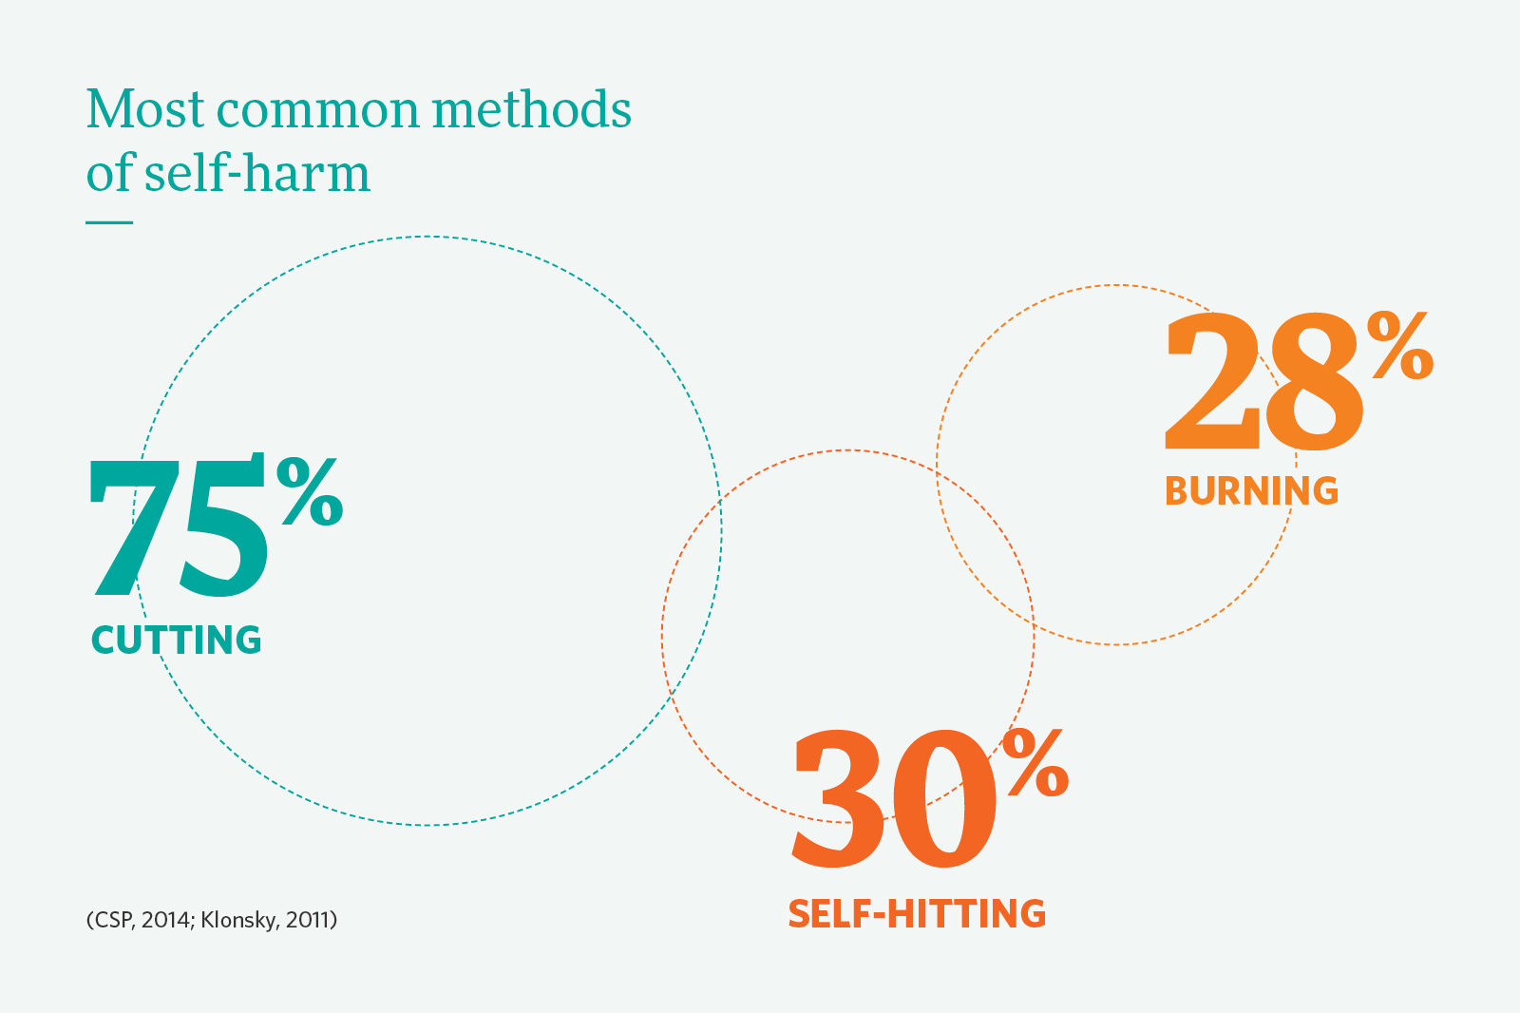

Slide 27
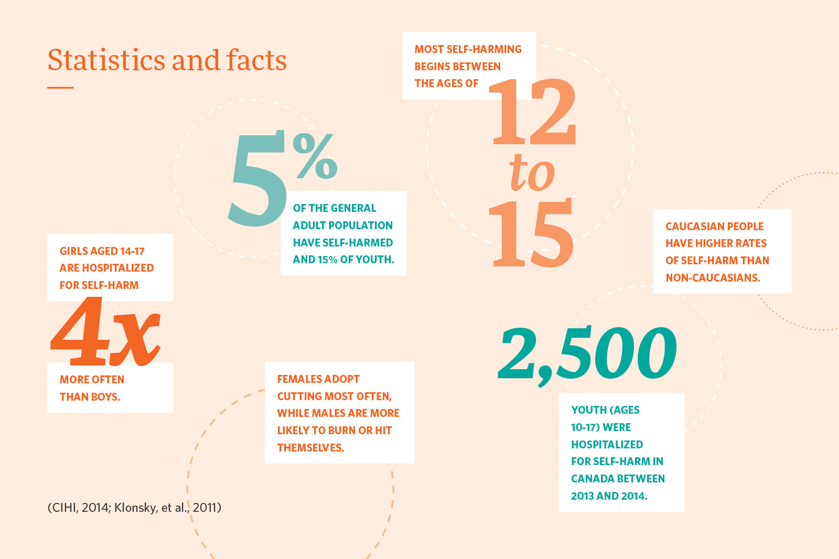

Slide 28
Suicidal intensity, plan, intent, means
Asking about suicide does not increase an individuals suicidal risk, in fact, research has shown this to not be true and, has shown that asking someone if they are having thoughts of killing themselves is actually more likely to save a life.

Slide 29
Suicidal intensity, plan, means, intent,
Ask direct questions regarding a plan, if they have one
Can that plan be carried out immediately
Does the person have the ability to carry out that plan
Do they have the immediate intent or what is the time frame
What is their level of suicidal intensity
0-10

Slide 30
